Slide 1
Dallas County Residential Home Values Analysis
Prepared by:
Marcus Kim
John Millar
Joe Swiderski
Julas Hollie

Slide 2
Introduction
Overview
- Analysis of Dallas County home prices over the past 5 years to project
Goal
- determine what is the best investment in the next 3 years in Dallas home market.
Methodology
- By analyzing dallas county housing value based on property features and market.
Conclusion

Slide 3
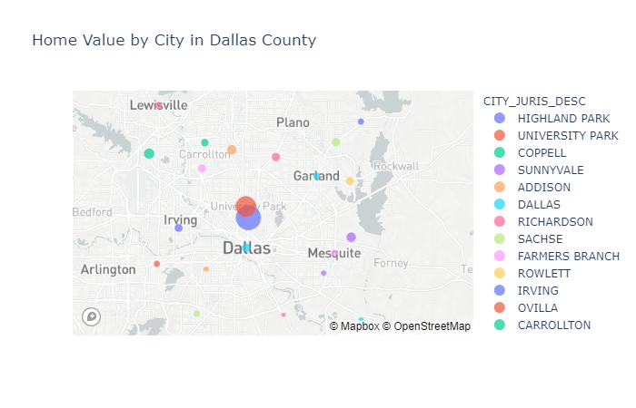
Dallas County Real Estate Values

Slide 4
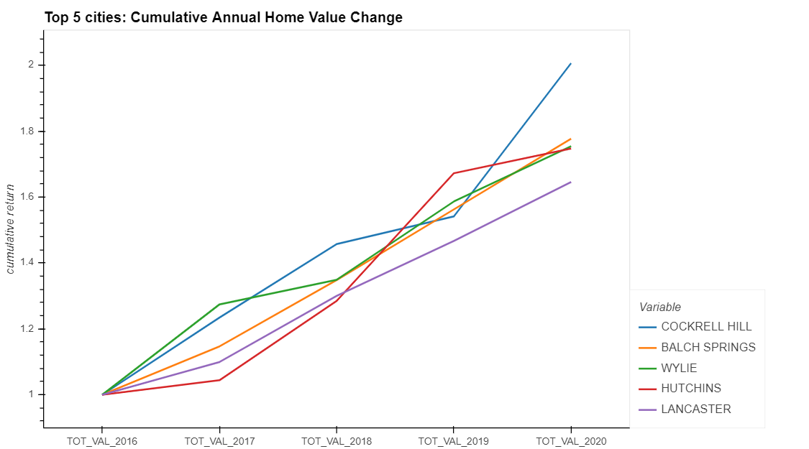
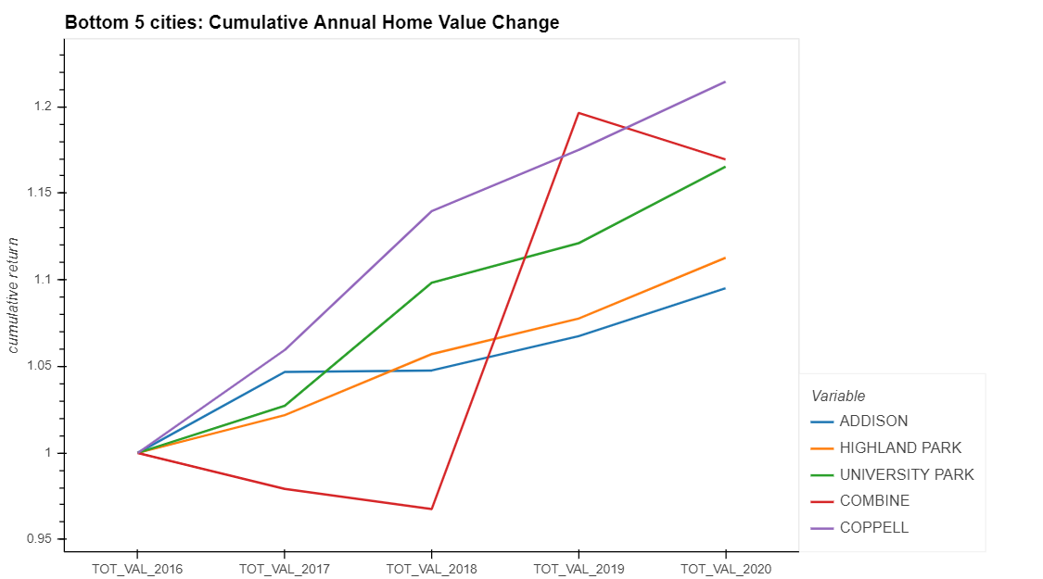
Dallas County Real Estate Values
Notes:
Percentage (cumulative) chart by city – line chart
Top 5
Bottom 5

Slide 5
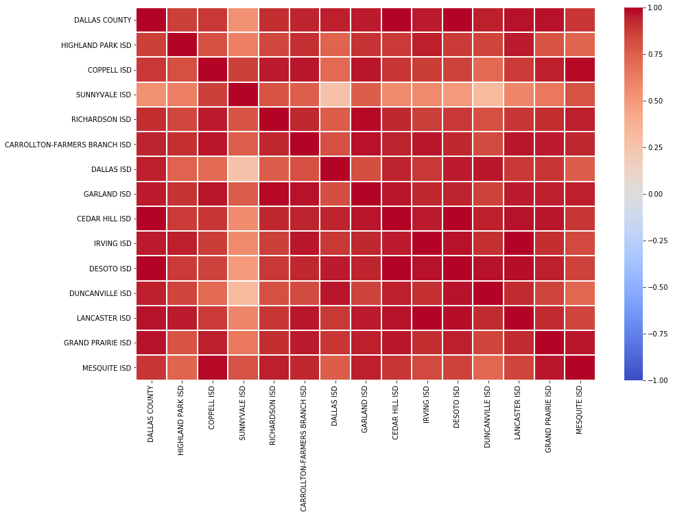
Dallas County Real Estate Values

Slide 6
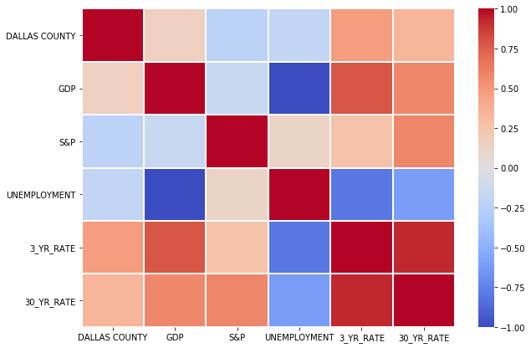
Forward Looking
Notes:
Heat map for Dallas County vs. Market

Slide 7
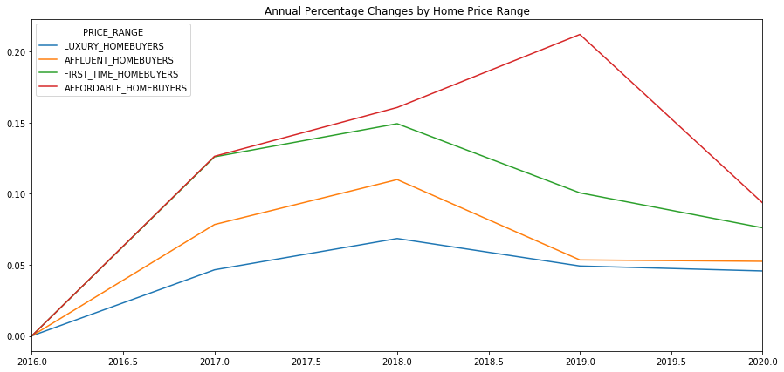
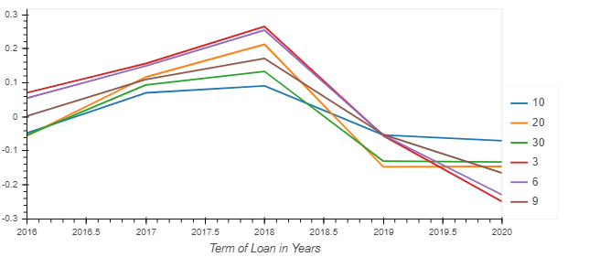
Dallas County Real Estate Values
Notes:
Line chart by property type + interest rates

Slide 8
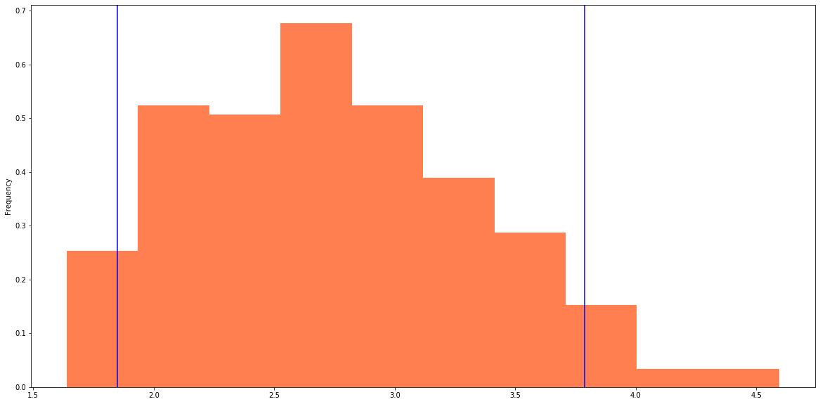
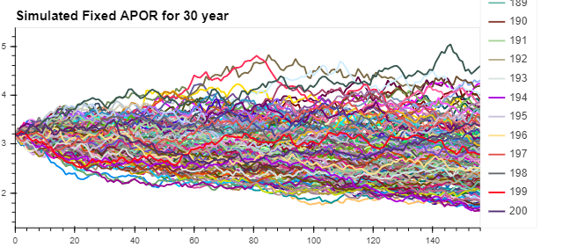
Forward Looking
Notes:
Monte Carlo apr projection next 3 years

Slide 9
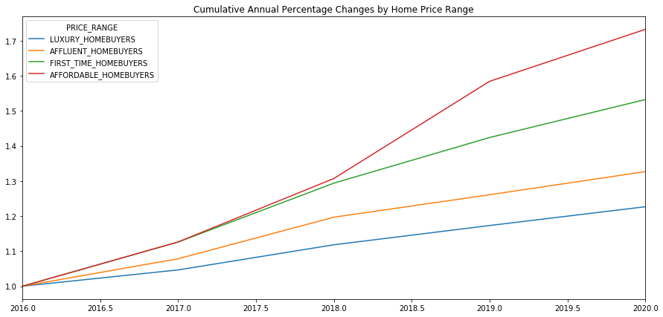
Dallas County Real Estate Values
Notes:
Property Feature
Affordable, luxury, etc.
Bubble chart real time walkthrough (switch to jupyter)

Slide 10
Conclusion
ISDs do not affect home values
Unemployment is negatively correlated to home values and GDP growth.
Home value is negatively correlated to S&P 500. We believe this is because of the recent volatility in the market.
In a decreasing rate environment, we’d expect affordable homes(less than $150K) to have the greatest percentage change in home price.
According to the Monte Carlo Simulation, the rates are projected to drop another 50 bps, therefore, the optimal investment is the affordable home over the next 3 years.
Notes:
Property Feature
Affordable, luxury, etc.
Bubble chart real time walkthrough (switch to jupyter)

Slide 11
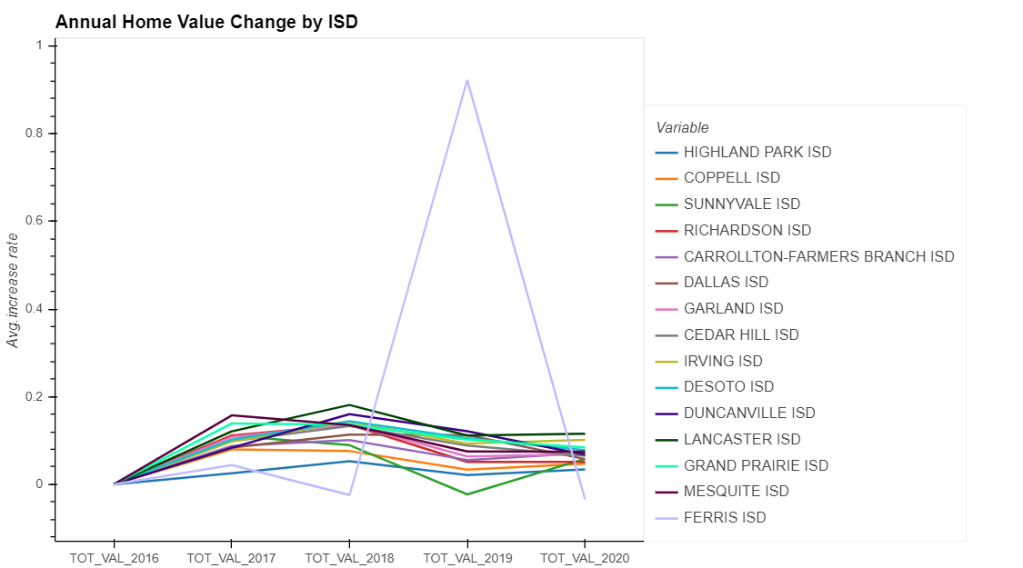
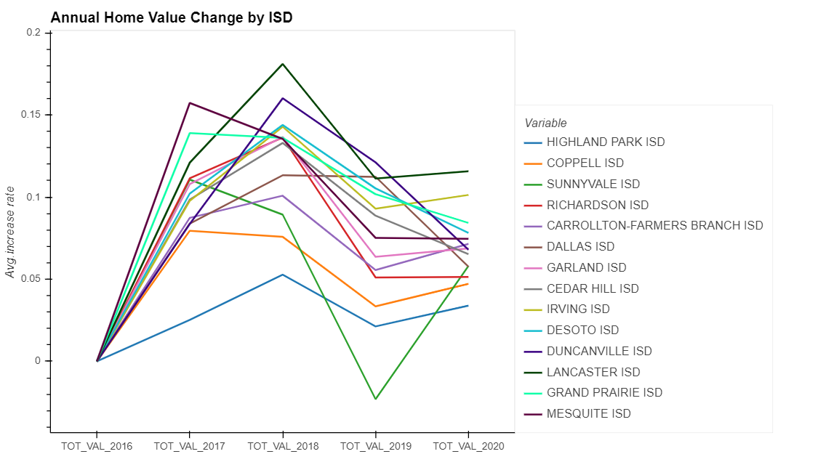
Dallas County Real Estate Values
Notes:
Property Feature
Affordable, luxury, etc.
Bubble chart real time walkthrough (switch to jupyter)

Slide 12
Appendix
Data sources
Notes:
Property Feature
Affordable, luxury, etc.
Bubble chart real time walkthrough (switch to jupyter)

Slide 13
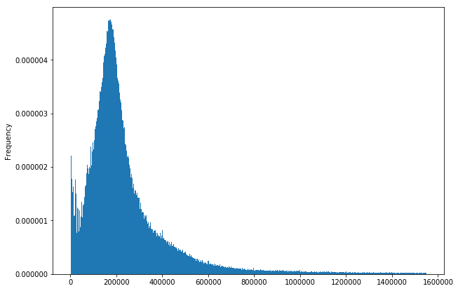
Dallas County Real Estate Values
Notes:
Property Feature
Affordable, luxury, etc.
Bubble chart real time walkthrough (switch to jupyter)

Slide 14
Question Session
Notes:
Property Feature
Affordable, luxury, etc.
Bubble chart real time walkthrough (switch to jupyter)

